Slide 1
Virtual memory
Oleg Ladin
01.03.2021

Slide 2
Layers of Abstraction in Computer Science
Application
Algorithms
Programming Language
Operating System
Topics of this lecture
Instruction Set Architecture
Microarchitecture
Gates/Register-Transfer Level (RTL)
Circuits
Physics

Slide 3
Agenda
Virtual memory
Page table
TLB
Virtual memory HW optimizations

Slide 4
Virtual Memory

Slide 5
Memory management
address N
Stack
Local variables in func. calls
Before: the whole machine for one program
Resources are managed manually by the SW developer
No “external” SW with unknown requirements
Now: multi-tasking
It’s effective to share resources between processes
Co-existence of many unknown processes cannot be planned
How multiple processes share memory?
What if a process accesses memory of another process?
What if process needs more memory and there is left?
What if a new process is spawned?
stack growth
dynamic part
heap growth
Heap
Dynamic memory allocation
BSS (block starting symbol)
Uninitialized static variables
Data
Initialized static variables
static part
Text
Executable code
address 0

Slide 6
Virtual & physical memory
The virtual address space
Perfect abstraction = contiguous and completely belongs to the process
Visible to the programmer
The physical address space
The real computer memory (e. g. DRAM) used by multiple processes
Hidden from the programmer by OS and HW
How to map the virtual space to the physical one?

Slide 7
Basic Idea of VM
One process = one virtual address space
Split virtual and physical spaces into blocks of fixed size (usually 4KB) – pages
Only pages used by the process are stored in computer memory
No need to place the whole virtual space
Pages can be in physical memory or a disk
Memory acts as a cache for the secondary storage – the disk
Process may use more pages than physical memory can keep
#page
0
1
2
3
4
5
6
…
…
91
92
93
…
…
Physical Space
Virtual Space
#page
2
19
40
41
Disk
#page
60
122

Slide 8
Virtual memory advantages
Isolation of processes
VM prevents them from illegal accessing the memory of one another
Illusion of large memory
VM size can be bigger than physical memory size
Illusion of contiguous memory
Programmers need not worry about where data is placed exactly
Dynamic memory growth
Can add memory to processes at runtime as needed

Slide 9
Page Table

Slide 10
Page Table
Contains the following information for each page:
Is the page in memory or on the disc?
A physical address of the page (if it is in memory)
Was its data modified? → need for evictions
Access rights (read-only, read-write, etc.) → security
Each process has its own PT
All complex tasks (initialization, misses, evictions, etc.) are performed by OS
HW uses PT only to translate virtual addresses into physical addresses

Slide 11
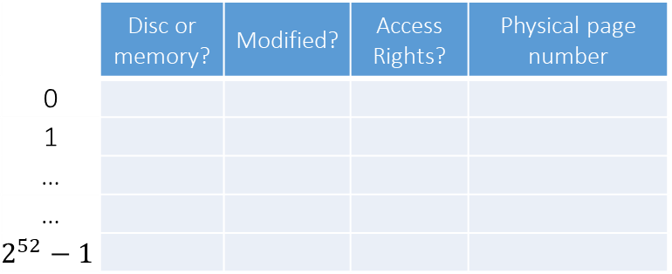
Translation
Virtual Address
63 | 11 | 0
Virtual Page Number | Page Offset
Page Table
 | Disc or memory? | Modified? | Access Rights? | Physical page number
0
1
…
…
$$2^{52}−1$$
31 | 11 | 0
Physical Page Number | Page Offset
Physical Address

Slide 12
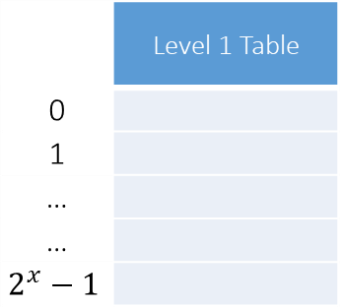
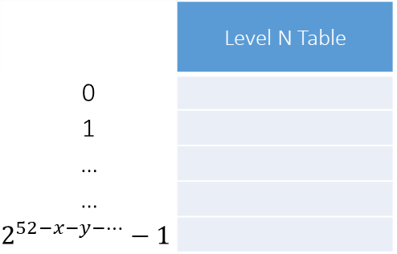
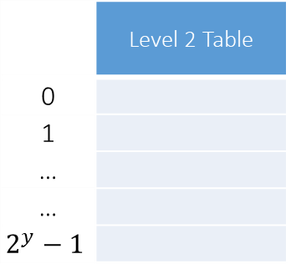
Page table structure
Implementation of a page table is defined by OS
Usually it is a multi-level table
Accessing of final page table entry is a chain of loads (“walk”)
Effective when pages are sparse in the virtual address space
63 | 11 | 0
Virtual Page Number | Page Offset
31 | 11 | 0
Physical Page Number | Page Offset
 | Level 1 Table
0
1
…
…
$$2^{x}−1$$
 | Level 2 Table
0
1
…
…
$$2^{y}−1$$
 | Level N Table
0
1
…
…
$$2^{52−x−y−…}−1$$
...

Slide 13
Translation failures
The virtual address is invalid → “Segmentation fault” exception is raised
When no PT entry were allocated for this virtual address by OS
The page is not in physical memory → Page fault
HW saves the current state and gives control to OS
OS detects the page causing the fault
OS evicts some page, if no free pages left in physical memory
OS loads the page from a disk to physical memory
OS updates the PT entry (a physical address and “on disk?” bit)
OS gives control back to HW

Slide 14
Context protection
One process must not access physical memory of another process
Each process has its own page table therefore
How to write to PT? CPU works in 2 modes at least
Kernel mode:
entered by syscall
has write access to PTs of all processes
knows what physical addresses are
User mode:
return from kernel mode by eret instruction
operates only with own PT in a read-only manner

Slide 15
TLB - Translation Lookaside Buffer

Slide 16
TLB
PT is too huge to be in HW → it is stored in memory
There are multiple methods to compact it
Each translation requires several memory accesses
Needed for every load or store → too many!
Data cache helps, but not much
TLB caches recently used PT entries
speed up translation
typically 64 to 256 entries
usually 2 to 8 way associative
TLB access time is faster than L1 cache access time
Virtual Address
TLB Access
Access
Page Table
No
TLB Hit ?
Yes
Physical
Addresses

Slide 17
PT + TLB + Cache
Virtual Address
Access
TLB
Access
Cache
Access
Page Table
In Memory
L2 Cache
Hit ?
No
L1 Cache
Hit ?
L2 Cache
Hit ?
No
TLB
Hit ?
No
No
Access
Memory
Yes
Yes
Physical
Addresses
Data

Slide 18
Handling TLB miss
TLB miss can be handled by SW:
Exception is raised, control is given to OS
OS fetches a PT entry from memory and writes it into TLB
or by HW:
Handled as a usual cache miss
RISC-V allows both, x86 uses HW, MIPS - SW

Slide 19
TLB protection
Simplest solution — flush TLB on context switch
Not optimal if “new” context switches back early
Performance-friendly solution — process id is a part of TLB tag
Translate for different contexts simultaneously
Safe: one context will not read TLB entries of other contexts

Slide 20
HW optimizations

Slide 21
Optimization 1: overlapped TLB & cache access
38
11
0
Virtual Memory view of a Physical Address
Physical Page Number
Page offset
6
5
0
Cache view of a Physical Address
tag
set
disp
#Set is contained within the Page Offset
The #Set is known immediately
Cache can be accessed in parallel with address translation
Once translation is done, match upper bits with tags
Limitation: Cache ≤ (page size × associativity)

Slide 22
Optimization 2: virtually-addressed cache
Address translation only done on a cache miss
Problem 1: two virtual pages mapped to the same physical page
Must not reside in the cache together
On a cache miss, use a reverse TLB to verify that no other cache line already in the cache mapped to the missed physical address
Problem 2: flush cache on context switch
Alternatively: add process ID as part of the tag
CPU
data
Cache
data
Main
Memory
VA
TLB
PA

Slide 23
Thank You

Slide 24
Open questions: free discussion
What address should be used for store forwarding?
What address space should be used for prefetching logic?

Slide 25
Meltdown
OS kernel keeps some of its data in the process PT
Effective for exceptions handling
Reading requires kernel privileges, but it still can be read speculatively:
# speculative path after a conditional branch:
lw $r1, 0x0($r2) # [$r2] is in kernel-space memory
andi $r1, $r1, 0x1 # read the bit 0 (may be any)
slli $r1, $r1, 0x40 # 0, if the bit is 0, else 0x40
addi $r3, $r3, $r1
lw $r4, 0x0($r3) # fill the cache with [$r3] or [$r3 + 0x40]
# ...
lw $r4, 0x0($r3) # measure exec. time of this instruction

